Slide 1

Stock Market Data Analysis
John-Paul Besong,Dounglan Cheung,Mario Garcia, Jeremy Gavrilov, Zachary Pinter

Slide 2
Overall Concept
Impact of Covid-19 on Global Business.
Using Sentiment Analysis to predict fluctuations in stock pricing. Focusing on:
Tweets about specific companies.
Trending words when stocks spike up/down.
Correlation with these and stock prices.

Slide 3




The Chosen Ones: AAL, Zm, nflx, tsla
Airlines
Deeply impacted by travel bans.
Zoom University
Meteoric rise in online classes.
Rise regardless of alleged privacy concerns.
Netflix
Higher percentage of free time due to quarantine.
Tesla
Dropping oil prices affecting electric car sales.
Automotive industry in recent decline.
These companies have been the most trending, leading to the most Twitter data.

Slide 4
Api’s Used
Twitter – Collecting Tweets
Numpy - Twitter Data Manipulation
TextBlob – Sentiment Analysis
Panda – Stock Data Manipulation
Alpha_Vantage – Stock Data
DateTime – Live Time Tracking
MatPlotLib – Graphing Stock Data

Slide 5
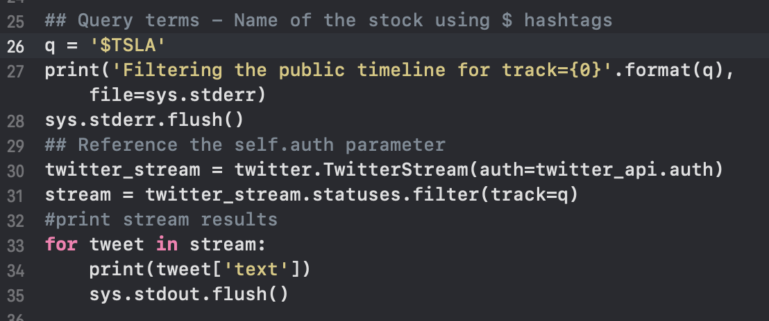
The code: Twitter data

Slide 6
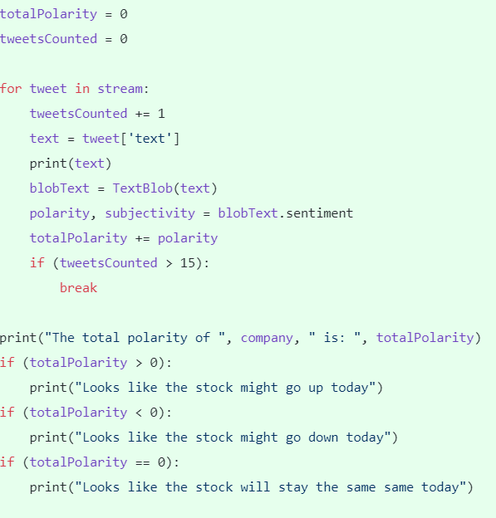
Premarket: Sentiment analysis
More tweets were counted than shown to have more accurate data. For demo purposes, 15 tweets will be collected.
Polarities were calculated for each tweet, and the total sum represented the final value for the analysis.
Searched only for official name (‘TSLA) to collect data from professional brokers.

Slide 7


Premarket Twitter data

Slide 8
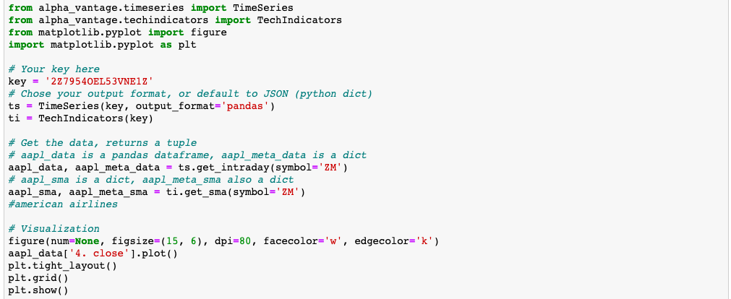
PostMarket: stocks

Slide 9
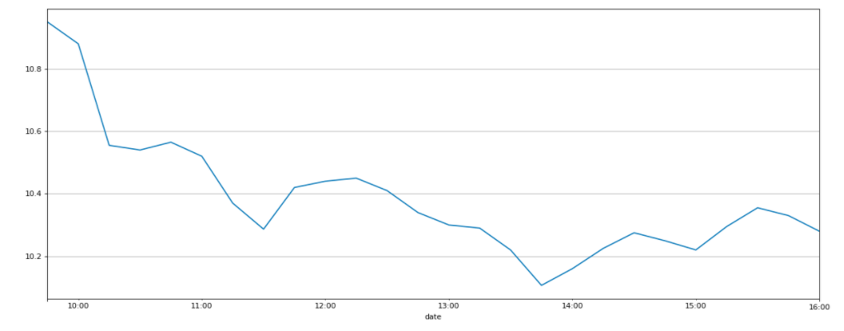
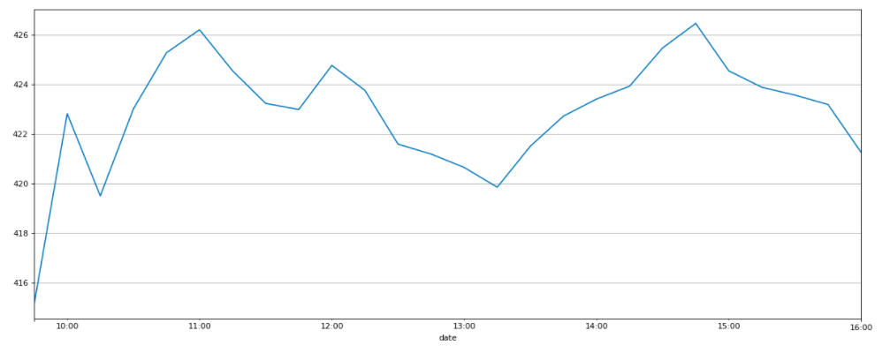
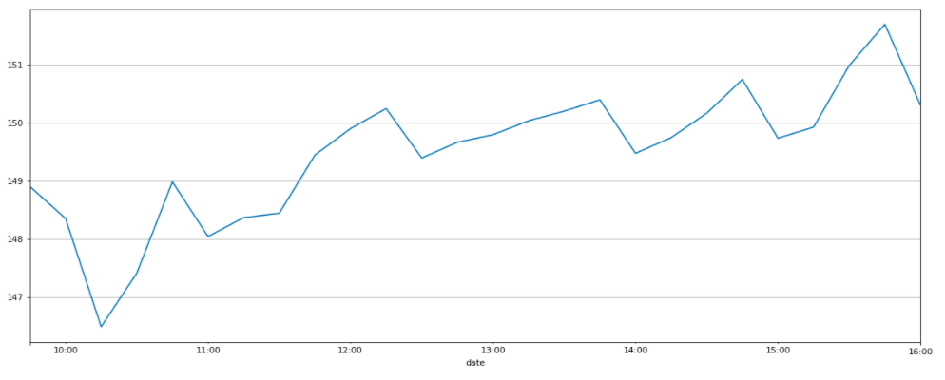
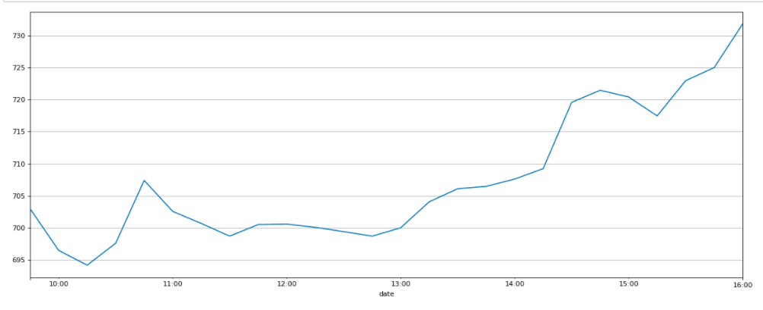
Stock data
Sentiment Analysis Results:
AAL: Stock Will Go Down
ZM: Stock Will Go Up
NFLX: Stock Will Go Up
TSLA: Stock Will Go Up
American Airlines
Netflix
Zoom
Tesla

Slide 10

Demo Time!

